Slide 1



Custom Pega Training for Ministry of Justice
Entry Level – 3 Day App Build

Slide 2


Pega Inception to app build in a day
Day 1

Slide 3


Day 1- Agenda & Introductions
Time | Topics
9:30 AM to 10:30 AM | BUSINESS PROBLEM - DESIGN THINKING SESSION
10:30AM – 12:30PM | REQUIREMENTS – PEGA DCO & APPLICATION BUILD
12:30 PM – 1:30 PM | LUNCH BREAK
1:30 PM – 3:00 PM | BUILD PART 1- PEGA CASE MANAGEMENT, SLAS, UI
3:00 PM – 3:30 PM | COFFEE BREAK
3:30PM – 5:30PM | BUILD PART2 – ADVANCED REQUIREMENTS & Q&A
5:30PM – 6:00PM | FURTHER LEARNING TIPS

Slide 4
9:30 AM – 10:30 AM
BUSINESS PROBLEM
-DESIGN THINKING SESSION

Slide 5

Business Scenario for the day
Citizens of the future in KSA need a modern lawsuits filing system that is easy to use. MoJ would like to build and trial an app that can be offered as a service to smart cities.
Capture information for - plaintiffs, defendants, agents or attorneys, subject and type of case with minimum hassle and automation
.
Can I check e filling options on mobile
Is it easy and quick
Will I be asked lots of documents
Will I get my application updates

Slide 6
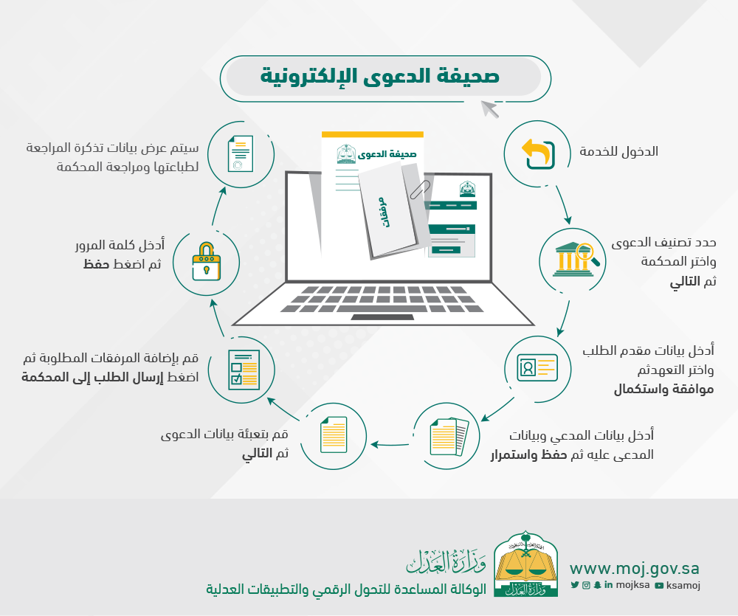

High Level Business Process
https://www.moj.gov.sa/ar/eServices/Pages/Details.aspx?itemId=11

Slide 7
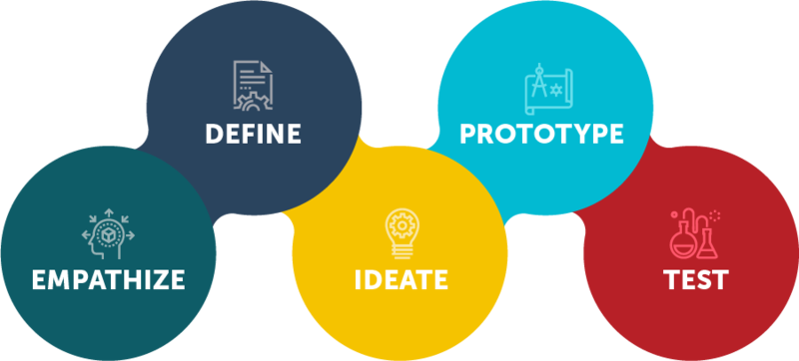
Design
Thinking
Personas
Role of Objectives
Decisions
Challenges
Pain Points
Mockups
Storyboards
Keep it simple
Fail fast
Iterate quickly
Interviews
Shadowing
Seek to Understand
Non Judgemental
Understand Impediments
What works?
Role play
Iterate quickly
Share Ideas
All ideas worthy
Diverge/Converge
Yes and Thinking
Prioritize

Slide 8


Ideation - Session today
Put one-liner design features you want to see in e-filling application on sticky notes – 15 min
Focus on Solution Rather than Business Objectives : Focus on How ( Business Solution ) rather than What ( Business Objectives )
Stupid and wild ideas are good: Value all ideas , Avoid the devil’s advocate:
Generate as many ideas as possible: Quantity more important than Quality
Stay on time: Don’t let your ideation session spiral out of control.
Consistency is not necessary
Prioritization discussion – 15 min

Slide 9
Our guess – We think you decided …..
Ability to file electronic Lawsuit.
Simplicity of the process
Don’t ask for information that you already have on me
Give me instant decision
Attach the documents.

Slide 10

10:30AM – 12:30PM
REQUIREMENTS – PEGA DCO & APPLICATION BUILD

Slide 11
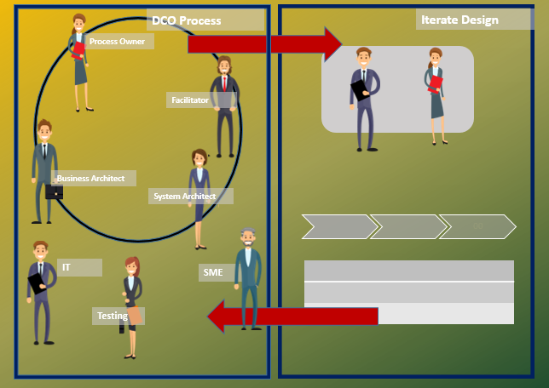

DCO – Direct Capture of Objectives
Pega provides number of features to directly capture business requirements in the tool, build and co-produce working software to fast-track solutions
Business process owner, IT SMEs, Pega Experts and Operations team doing it together is the best approach to get solutions first-time right.

Slide 12


Coupling DCO with CICD / DevOps
Development
Continuous Integration
Deployment
Continuous Delivery
DCO
Ready to share test
Pre-Prod
Deploy to Production
Publish to repository
Acceptance test
Ready to Ship Test
Work in Rules Branches. Author Unit test Release toggle | Unit Tests Guardrail Compliance | Package and export application. Publish it to a repository | Import from repository into test systems UI Tests Other Integration test | Performance Compatibility UAT | Import into Pre-Production environment. Tests against a production like Enviornment | Deployed on Demand or Automatically

Slide 13
Lets start building – Electronic Lawsuit Service!
Start here – All the content, access and URLs at -
https://github.com/eai-systems/xxxxx
Pega Training Lab - http://xxxxx:8080/prweb
Admin Login – XXXx/ xxx
Create your own login - XXadmin (XX – your initials)
Create your electronic lawsuit filling Application – MOJ

Slide 14
App
Studio
Business Analysts application developer, Front end (UI/UX) Developer, Data Engineers
Dev.
Studio
Experienced Application developers, Account admins, Security Admins.
Predictive
Studio
Data Scientists and Decision Architect
Admin
Studio
System Administrators
Pega Studio

Slide 15
Case Design – Processes and Steps
Roles play - Assign DCO session roles
Group Discussion - Quick flowchart of e filling process
Designing e filling Application case lifecycle discussion and build
Build Exercise
Stages – Transfer of authority or significant status change
Processes & Steps - verb + noun

Slide 16
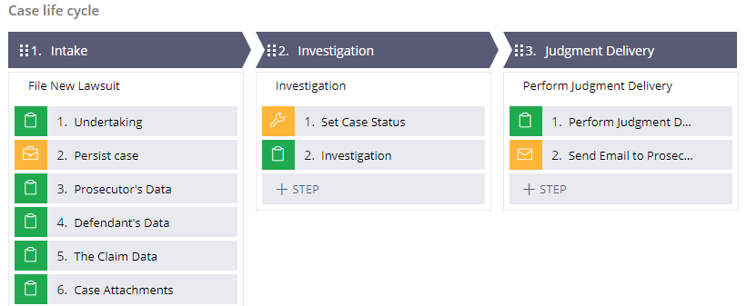
Stages, Process and Steps
Stages represent the transfer of a case from one case worker to another or a significant change in status of a case.
A process contains a series of tasks or steps, that a user completes as they work the case.
A step is either a user action or automated action performed by the application.

Slide 17
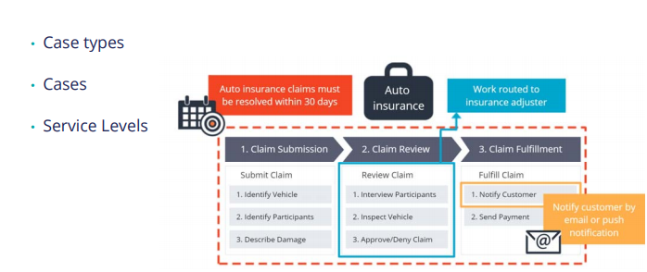
Model Driven Application Development
Case Types | Case | Service Level

Slide 18




Case and Case Type
Case Life cycle is the modeling technique used to describe how a business application should work.
In a pega application, you use case types to model repeatable business transactions.
A case type is an abstract model of a business transaction. A case is a specific instance of the transaction.
Intake
Investigation
Judgment Delivery
Case MOJ-20200218-1
Case MOJ-20200218-2

Slide 19
12:30AM – 1:30PM LUNCH BREAK 1:30AM – 3:00PM BUILD PART 1- PEGA CASE MANAGEMENT, SLA,UI

Slide 20
Summary Of Tasks
Building responsive User Interface
Routing tasks
Using SLA (timers)
Configure email notifications
Test your work on your laptop

Slide 21



Service Level Agreement
A service level agreement (SLA) establishes a deadline for work completion. When you establish a goal or deadline, Pega creates a service level agreement for you.
Goal: The goal defines how long the assignment should take. It is typically measured from when the step, assignment or case begins.
Deadline: The deadline defines the amount of time the step or case may take before it is late. The deadline is measured from when the step, assignment or case begins.
Passed Deadline: The passed deadline milestone defines when to take further action because the step, assignment or case is past the deadline. It measures the time that has passed since the deadline for a still open assignment.
Start
Step begins
Goal
Occurs once
Deadline
Occurs once
Passed Deadline
Can repeat

Slide 22

Work Routing Options
Current user : you can route the assignment to current user if the current user should perform the task
Specific user : you can route the assignment to the worklist of a specific user, for example bank officer or manager for approval
Work queue: you can route to a specific group when anyone in the group can complete the assignment. For example payroll department that creates and sends payment to employee
Customer(s)
Customer(s)
Bank Officer

Slide 23
3:00 PM – 3:30 PM COFFEE BREAK
3:30PM – 5:30PM BUILD PART 2 – ADVANCED REQUIREMENTS & Q&A

Slide 24
Summary Of Tasks
Complex calculations
Declarative processing
Process Automation
Duplicate Check
Reporting
Test your work on your laptop

Slide 25
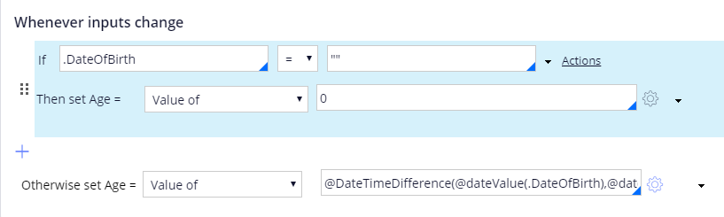
Declarative processing
Here is an example of using declare expression to calculate age of the person who is filling a lawsuit. Make your own formulas and implement.

Slide 26
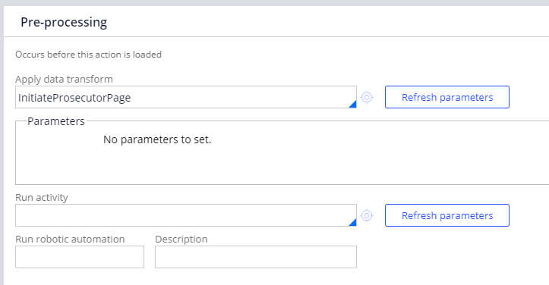
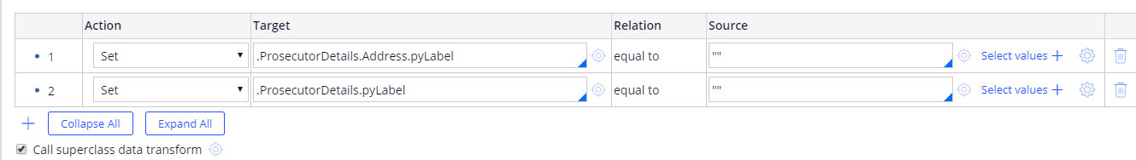
Using Flow Actions & Data Transforms for background processing

Slide 27
5:30PM – 6:00PM FURTHER LEARNING TIPS – Q&A

Slide 28
Learning and Tips
How to Build an App in Minutes with No Code
https://www.pega.com/insights/resources/how-build-app-minutes-no-code
What’s new in Pega 8.2
https://community.pega.com/video-library/search?f%5B0%5D=series%3A11766
Create an email account https://community.pega.com/sites/default/files/help_v82/procomhelpmain.htm#data-/data-emailaccount/creating-an-email-account-tsk.htm
View application on mobile https://community.pega.com/sites/default/files/help_v81/procomhelpmain.htm#mobile/concepts/mob-pega7-mobile-app-con.htm

Slide 29
Thank you
Any Questions?

